Slide 1
EPOS autumn school
EZ diffusion model workshop
Steven Miletić

Slide 2
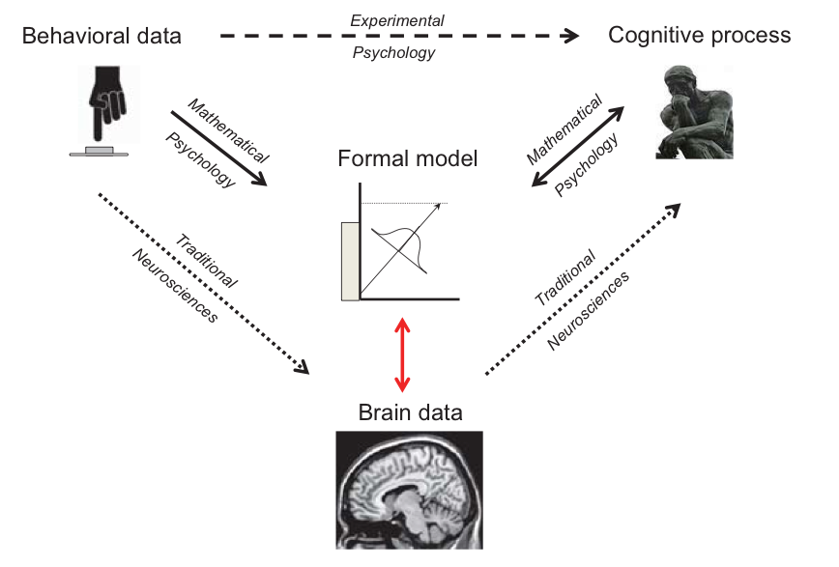
Me

Slide 3
Today
Not: become experts at cognitive modelling (sorry)
Introduction to the EZ diffusion model
Get an idea of what is possible with RT data

Slide 4
Lexical decision task
Zebra

Slide 5
Lexical decision task
Drapa

Slide 6
Lexical decision task
Bird

Slide 7
Lexical decision task
Zrdae

Slide 8
Reaction time distribution

Slide 9
Reaction time distribution

Slide 10
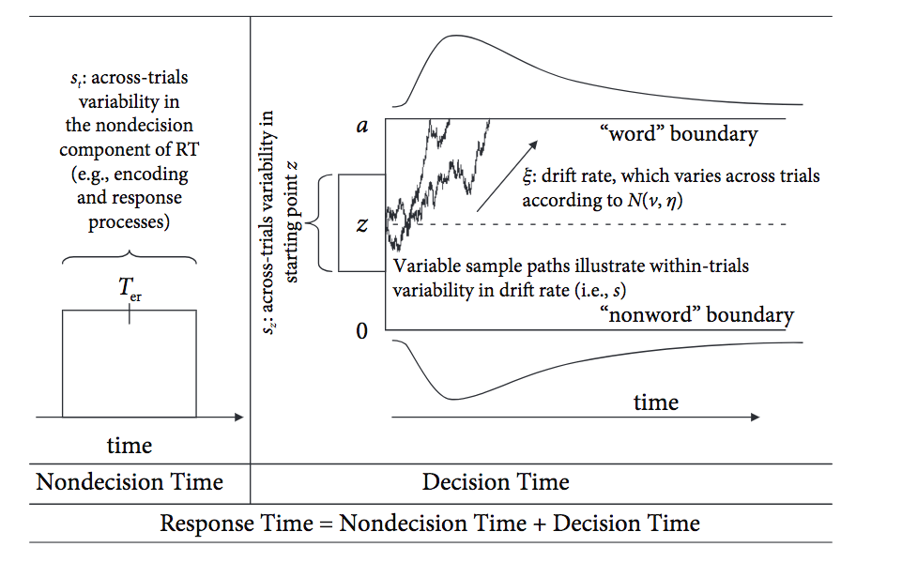
DDM
Parameters:
Start point z
Threshold a
Drift rate 𝛏
Non-decision time Ter
Between-trial drift rate variability 𝛈
Between-trial start point variability s_{z}
Between-trial non-decision time variability s_{Ter}
Ratcliff (1982)

Slide 11
Reaction time distribution
Caution = 3
Drift = 2
Bias = .1
Mean = 1.03s

Slide 12
DDM
Parameters:
Start point z
Threshold a
Drift rate 𝛏
Non-decision time Ter
Between-trial drift rate variability 𝛈
Between-trial start point variability s_{z}
Between-trial non-decision time variability s_{Ter}
Ratcliff (1982)

Slide 13
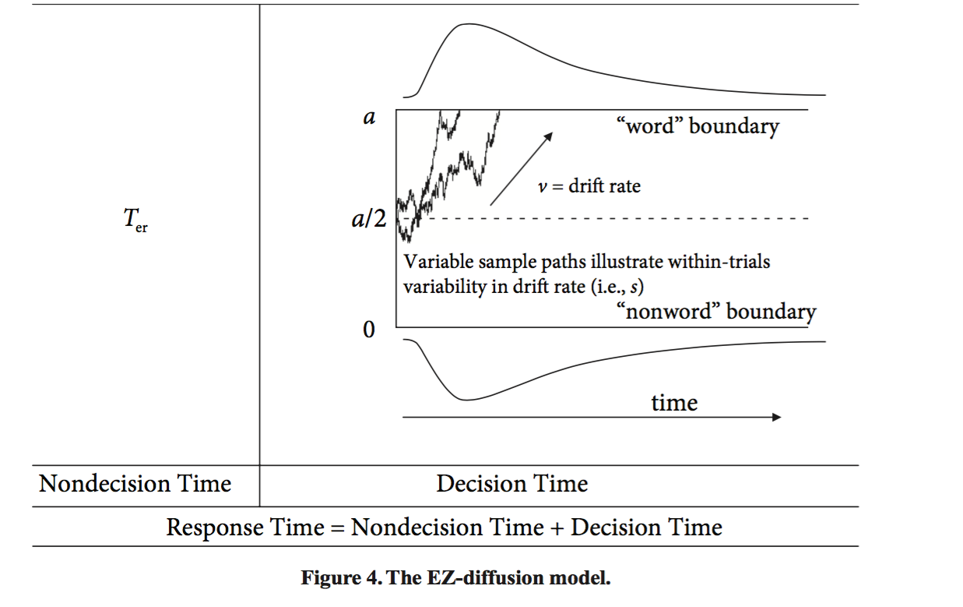
EZ
Assumptions:
Start point = 0.5*a
No between-trial variances
Parameters:
Threshold a
Drift rate v
Non-decision time Ter
Wagenmakers et al. (2007)

Slide 14
Why is EZ easy?
You can calculate a, v, Ter, directly from your data
No model-fitting procedure necessary
..but only if EZ’s assumptions are valid

Slide 15
This tutorial
Exploring relations between model parameters and data
Calculate EZ parameters
What happens to parameters when my data change?
When are parameter interpretations valid?
Getting to know what cognitive modelling is

Slide 16
Getting started
R
Standalone R: http://r-project.org/
RStudio: https://www.rstudio.com/
Never used R/no programming experience?
http://tryr.codeschool.com
EZ practical on Github:
www.github.com/stevenm1/ez
EZ_practical.html (code & assignments)
EZ_practical_answers.html (answers)
data
Assignments 1-5: EZ diffusion
Assignments 6-7: DDM simulation & fitting, for enthusiasts

Slide 17
Take-home messages
Analyze full reaction time distributions!
Go beyond the mean RT
Infer cognitive processes from behavioral data
NB: the assumptions of EZ are often violated!
EZ is too easy
For a comparison of multiple ways of model-fitting, see Ratcliff & Childers (2015) Decision

Slide 18
Want to learn more? Join our summer school!
www.modelbasedneuroscience.com

